Slide 1
Diabetic Readmission Risk Prediction
Jonathan Agustin
Zach Robertson
Lisa Vo
Notes:
Let’s get started. Welcome to our presentation on the Diabetic Readmission Risk Prediction system. Today, we'll demonstrate our machine learning solution implemented using AWS SageMaker. Our system addresses a critical healthcare challenge: predicting 30-day hospital readmissions for diabetic patients.

Slide 2
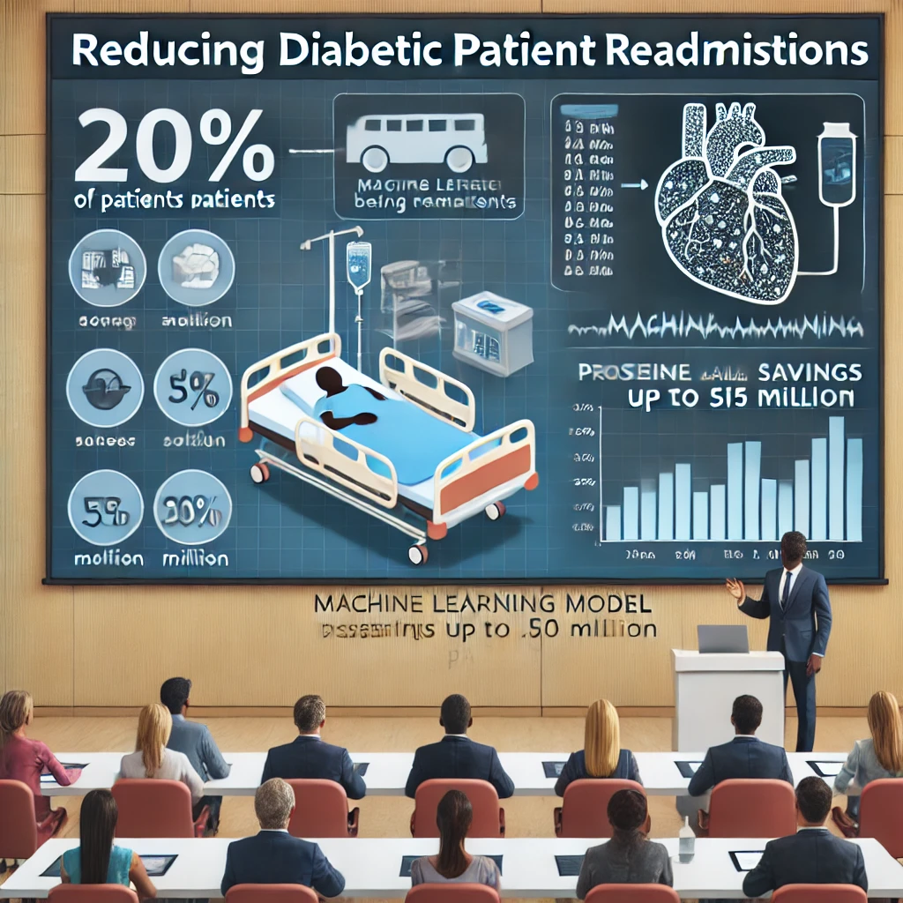
Slide 2
Hospitals face high costs due to diabetic patient readmissions, with 20% of patients returning within 30 days of discharge. Our solution uses machine learning to predict high-risk patients, enabling interventions that could reduce readmission rates by 10%, saving mid-sized hospitals up to $5 million annually and improving patient health outcomes.
Notes:
Let's begin by understanding the business problem we're solving. Hospitals face significant costs and challenges with diabetic patient readmissions. About one in five diabetic patients is readmitted within 30 days of discharge, costing hospitals millions of dollars annually. Our goal is to use machine learning to identify high-risk patients, enabling targeted interventions before they leave the hospital. We aim to reduce readmission rates by 10%, which could potentially save mid-sized hospitals up to $5 million each year. More importantly, this could lead to better health outcomes for patients, reducing their need to return to the hospital shortly after discharge.

Slide 3
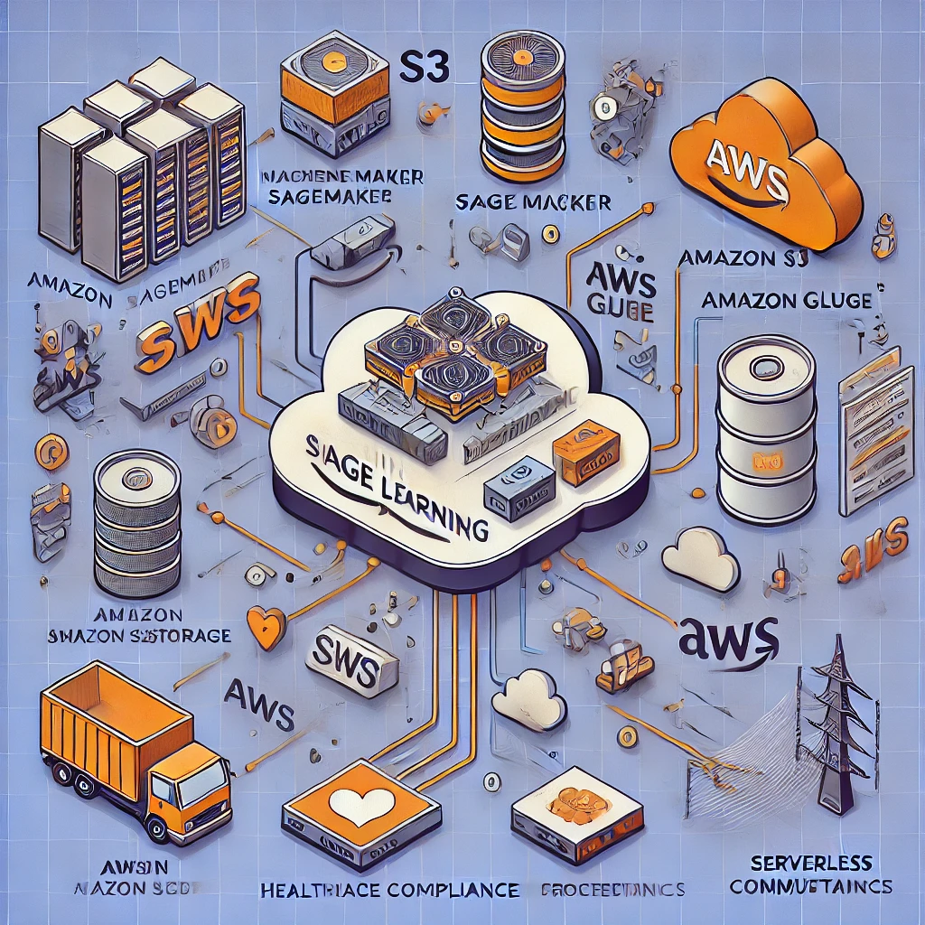
Slide 3
Our machine learning system architecture is built on AWS, using Amazon SageMaker for model training and deployment. Data is stored in Amazon S3, processed through AWS Glue, and computations are handled serverlessly via AWS Lambda. This design ensures scalability, regulatory compliance, and minimal maintenance.
Notes:
Now, let's examine the architecture of our system. If you're looking at our screen, you'll see a diagram of our ML pipeline. It's built entirely on AWS, with SageMaker at its core. We use Amazon S3 for data storage, which you can think of as a highly reliable, cloud-based hard drive. AWS Glue helps us with data processing, automatically discovering, preparing, and transforming our data. We also use AWS Lambda for serverless computations, allowing us to run code without managing servers.

Slide 4
Slide 4
Feature Store
Our system uses the SageMaker Feature Store to organize key patient data into groups such as demographics, medical history, current visit data, and derived features. This organization allows easy feature reuse, version control, and ensures reproducibility.
Patient Data
Medical History
Demographics
Current visit Data
Derived Features
Notes:
Our pipeline includes several key stages: data ingestion, where we gather patient information; preprocessing, where we clean and organize this data; feature engineering, where we create useful indicators for our model; model training, where our AI learns to make predictions; and finally, deployment, where we make our trained model available for use. This design ensures our system can handle large amounts of data and is easy to maintain, all while complying with strict healthcare data regulations.

Slide 5
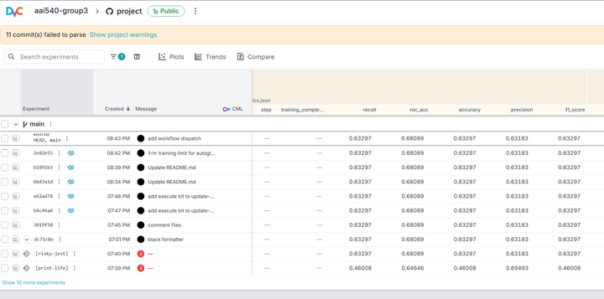
Slide 5
We manage our data using AWS SageMaker Feature Store, which organizes the data used by our machine learning model into several feature groups:
Patient Demographics – Includes age, gender, and ethnicity.
Medical History – Contains previous diagnoses and treatments.
Current Visit Data – Provides details about the patient’s most recent hospital stay.
Derived Features – Newly calculated data points that enhance predictive accuracy.
Notes:
Let's dive deeper into how we manage our data using the SageMaker Feature Store. On our screen, you can see the SageMaker Feature Store console. We've organized our features – the pieces of information our model uses to make predictions – into several groups. First, we have patient demographics, which includes things like age, gender, and ethnicity. Then we have medical history, covering previous diagnoses and treatments. We also have current visit data, which includes information about the patient's most recent hospital stay. Lastly, we have derived features, which are new pieces of information we've calculated that might be helpful for predictions.

Slide 6
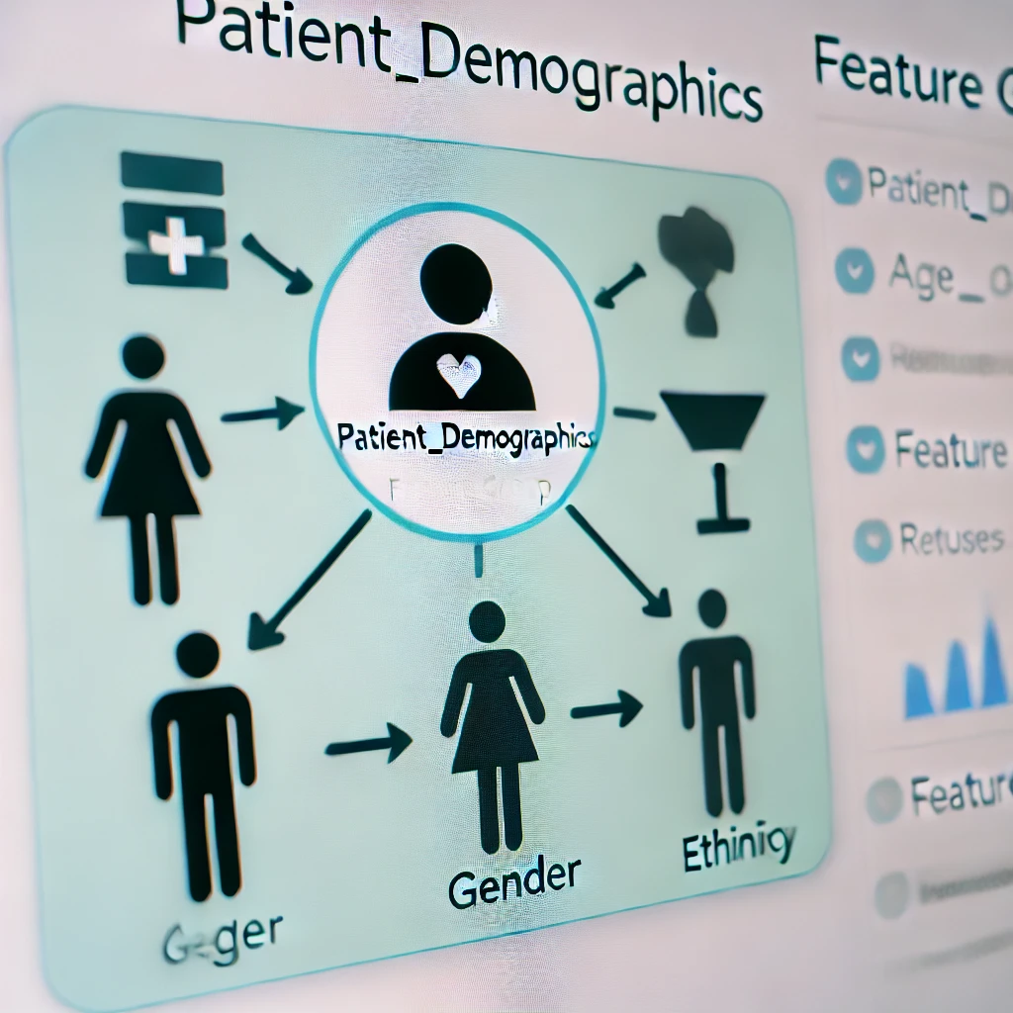
Slide 6
In our 'patient_demographics' feature group, data like age, gender, and ethnicity are stored. This approach promotes collaboration across teams and ensures feature consistency and trackability over time.
Notes:
For example, let's look at our 'patient_demographics' feature group. You can see it includes features like age, gender, and ethnicity. By organizing our data this way, we can easily reuse these features across different models and teams. It also allows us to version our features, ensuring we can reproduce our results and track changes over time.

Slide 7

Slide 7
We monitor system performance using AWS CloudWatch, tracking metrics like CPU utilization, memory usage, and API latency. Alerts are set for predefined thresholds to ensure proactive issue resolution.
Notes:
Monitoring is crucial for any healthcare application, so let's examine how we keep an eye on our system's performance. On our screen now is our CloudWatch dashboard. This is like a control panel for our entire system. The graphs and charts you see show key metrics like CPU utilization, which tells us how hard our computers are working; memory usage, indicating how much information our system is juggling at once; and API latency, which measures how quickly our system responds to requests.

Slide 8
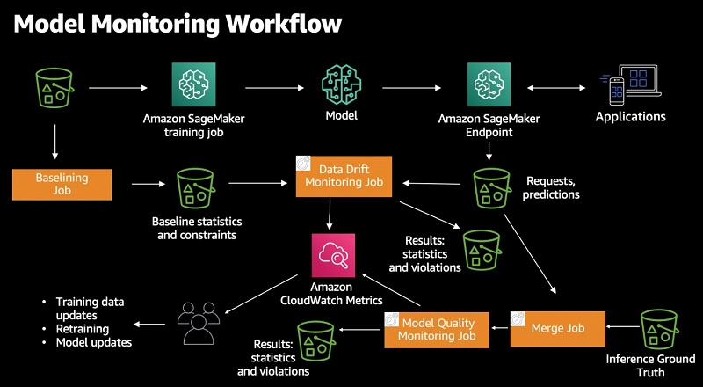
Slide 8
SageMaker Model Monitor tracks prediction distribution, feature importance, and accuracy over time. This allows us to detect performance degradation and shifts in prediction patterns.
Notes:
We've set up alerts for any of these metrics if they exceed predefined thresholds. For example, if the CPU utilization stays above 80% for more than 5 minutes, we'll get an alert. This allows us to proactively address any issues before they impact the system's performance or, more importantly, patient care.

Slide 9
Slide 9
We use Amazon SageMaker Model Monitor to continuously track the performance of our machine learning model. This tool helps us in the following ways:
Prediction Distribution: Monitors if the model is predicting high risk for more (or fewer) patients than usual.
Feature Importance: Tracks changes in the importance of features, alerting us if the model starts relying too much on a single feature.
Accuracy Over Time: Detects any degradation in model performance, allowing us to take corrective action promptly.
Notes:
Now, let's look at how we monitor our model's performance over time. We're using SageMaker Model Monitor for this, and you can see its console on our screen. This tool helps us track three key aspects of our model. First, it shows us the prediction distribution, which tells us if our model is suddenly predicting high risk for a lot more (or fewer) patients than usual. Second, it tracks changes in feature importance, alerting us if the model starts relying too heavily on one piece of information. Lastly, it monitors accuracy over time, helping us spot any degradation in our model's performance.

Slide 10
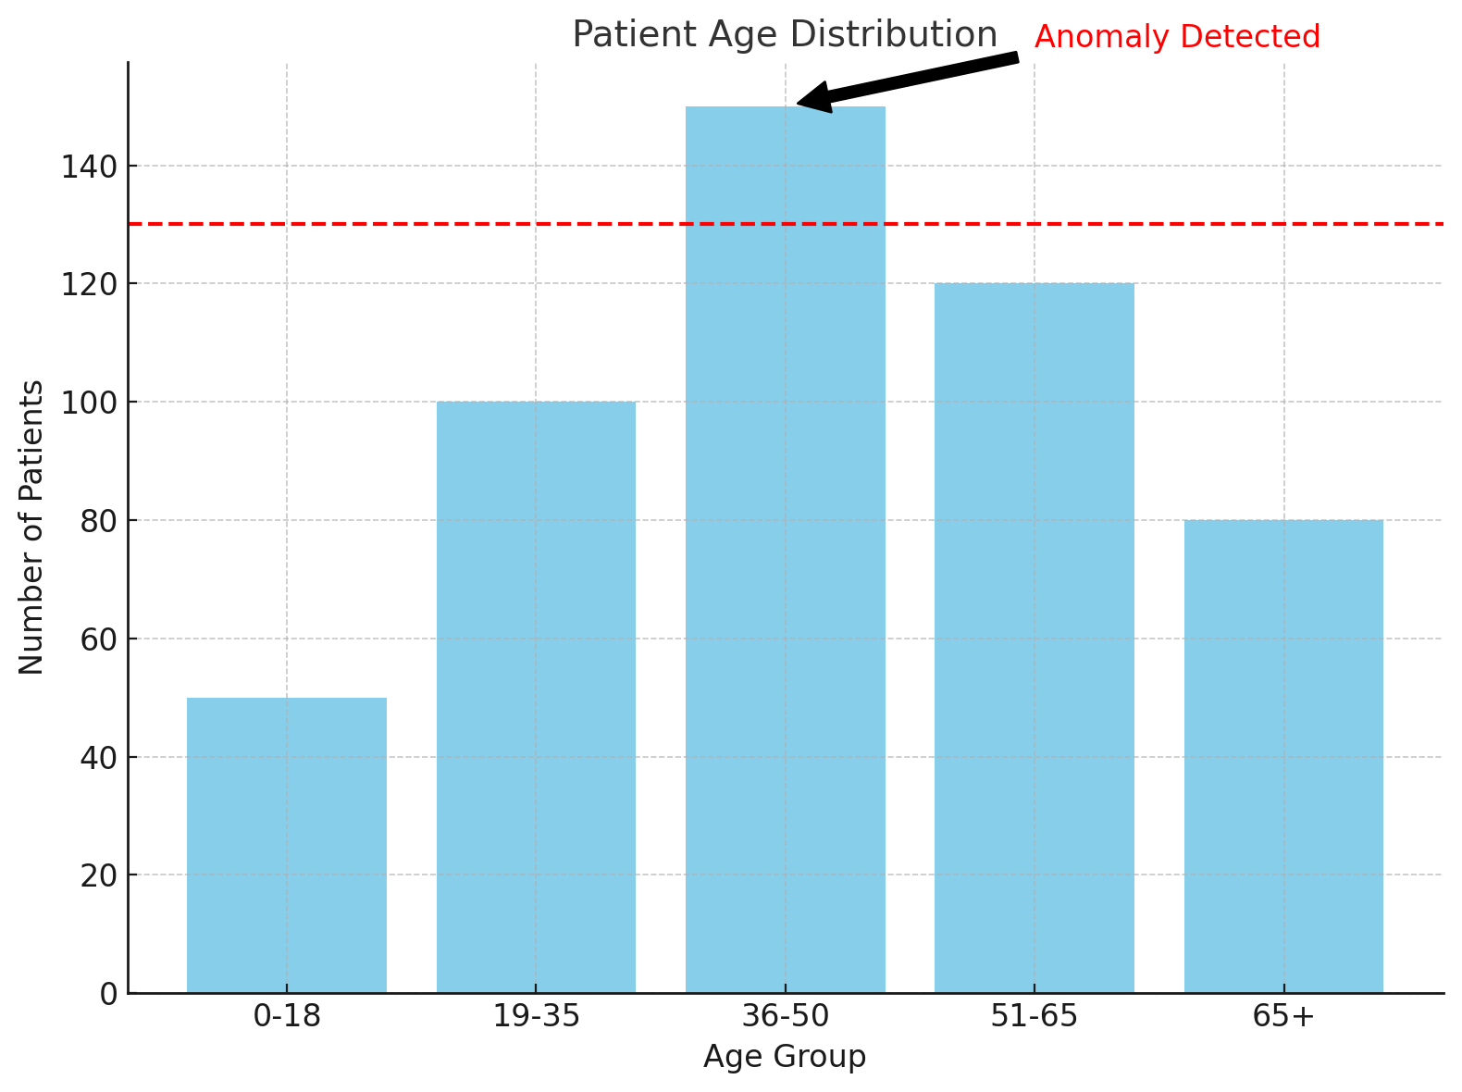
Slide 10
Example
Custom data quality checks, such as monitoring patient age distribution, are in place to detect issues with the data ingestion process, ensuring reliable and accurate input for the model.
Notes:
We've also implemented custom data quality checks. For instance, we monitor the distribution of patient ages. If we suddenly see a lot more young patients or old patients than usual, it could indicate a problem with our data ingestion process.

Slide 11
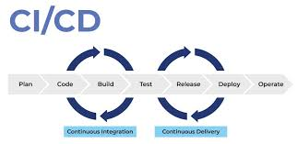
Slide 11
Our continuous integration and deployment pipeline, implemented with GitHub Actions, automates updates to the system, ensuring smooth and reliable model deployment.
Notes:
An essential part of our development process is our CI/CD pipeline, implemented with GitHub Actions. CI/CD stands for Continuous Integration and Continuous Deployment, and it helps us consistently and reliably update our system. On our screen, you can see the GitHub Actions console. This shows our automated workflow from code changes to model deployment.

Slide 12
Slide 12
Notes:
Let's walk through a typical process. When a developer makes changes to our code, GitHub Actions automatically runs tests to make sure nothing broke. If the tests pass, it proceeds to train a new model using the latest data. This new model is then compared against our current production model. If it performs better, it's flagged for human review. After approval, the new model is automatically deployed to a staging environment for final testing before being moved to production.

Slide 13
Slide 13
Notes:
Here's an example of a successful run, where you can see each stage completing successfully. And here's an example of a failed state, where a new model didn't meet our performance thresholds and was automatically rejected. This process ensures that only improvements make it to our production system, maintaining the quality and reliability of our predictions.

Slide 14
Slide 14
Notes:
Version control is crucial in machine learning projects, especially in healthcare where we need to track every decision. Let's look at our SageMaker Model Registry, which you can now see on the screen. This is like a catalog of all our models. We maintain our current production model, the previous three versions for quick rollback if needed, and any candidate models undergoing evaluation.

Slide 15
Slide 15
Notes:
Each model version is tagged with key metadata. This includes its performance metrics, like accuracy and ROC-AUC score; information about the dataset it was trained on; and any hyperparameters used in training. This level of detail ensures we have full traceability and reproducibility of our models, which is crucial for both regulatory compliance and continuous improvement.

Slide 16
Slide 16
Notes:
Now, let's demonstrate our system in action using SageMaker's batch transform job. This allows us to generate predictions for a large group of patients at once. On our screen, you can see we're starting a job to process data for 1000 recently discharged patients. Each patient record includes over 50 features, which our model will use to calculate a readmission risk score.

Slide 17
Slide 18
Notes:
The job is running now, and... here are the results. Our system has categorized the patients into high, medium, and low risk groups. For patients in the high-risk group, our system automatically triggers alerts to their primary care physicians, recommending follow-up appointments within a week of discharge. This proactive approach allows healthcare providers to intervene early, potentially preventing readmissions before they happen.

Slide 18
Slide 19
Notes:
While we're proud of our current system, we're always looking to improve. In the future, we plan to integrate real-time electronic health record data, allowing our model to update its predictions as new information becomes available. We're also working on implementing explainable AI techniques, which will help doctors understand why our model makes each prediction. This transparency is crucial for building trust in our system and helping healthcare providers make informed decisions.

Slide 19
Slide 20
Notes:
We're also exploring ways to expand our approach to other chronic diseases beyond diabetes, such as heart failure and COPD. Lastly, we're investigating federated learning techniques, which could allow us to train our models across multiple hospitals without sharing raw patient data, further enhancing privacy protections.

Slide 20
Slide 21
Notes:
During the development of this system, we faced several challenges that are worth noting. One significant issue was data imbalance. Readmissions, while costly, are relatively rare events. This means our dataset had many more examples of patients who weren't readmitted than those who were. We addressed this using advanced sampling techniques to ensure our model learned to predict both outcomes accurately.

Slide 21
Slide 22
Notes:
Another major challenge was ensuring HIPAA compliance. Working with sensitive healthcare data requires strict adherence to privacy regulations. We implemented end-to-end encryption and rigorous access controls to protect patient information at every stage of our pipeline.

Slide 22
Slide 23
Notes:
Looking to the future, we're mindful of potential scalability issues as we process larger datasets and expand to more hospitals. We're continually optimizing our data pipeline to handle increased load efficiently. We're also acutely aware of the potential for biases in our predictions, particularly against protected groups. We've implemented ongoing monitoring and adjustment processes to ensure our model remains fair and equitable as it evolves.

Slide 23
Slide 24
Notes:
In sum, our Diabetic Readmission Risk Prediction system demonstrates the immense potential of machine learning in healthcare. By leveraging AWS SageMaker and implementing robust MLOps practices, we've created a scalable, reliable solution that could significantly improve patient outcomes while reducing healthcare costs.
Our system exemplifies how artificial intelligence can augment human expertise in healthcare, providing valuable insights to help doctors make more informed decisions. As we continue to refine and expand this technology, we're excited about its potential to make a real difference in people's lives, helping to ensure that more patients can return home from the hospital and stay healthy.

Slide 24
Slide 25
Notes:
Thank you for your attention to this presentation of our Diabetic Readmission Risk Prediction system. We hope this demonstration has illustrated the power and potential of applying machine learning to critical healthcare challenges.

